Slide 1
Distributed Systems
Security
Chapter 9

Slide 2
Course/Slides Credits
Note: all course presentations are based on those developed by Andrew S. Tanenbaum and Maarten van Steen. They accompany their "Distributed Systems: Principles and Paradigms" textbook (1st & 2nd editions).
http://www.prenhall.com/divisions/esm/app/author_tanenbaum/custom/dist_sys_1e/index.html
And additions made by Paul Barry in course CW046-4: Distributed Systems
http://glasnost.itcarlow.ie/~barryp/net4.html

Slide 3
Security Threats, Policies, and Mechanisms
Types of security threats to
consider:
Interception
Interruption
Modification
Fabrication

Slide 4
Example: The Globus Security Architecture (1)
The environment consists of multiple administrative domains.
Local operations are subject to a local domain security policy only.
Global operations require the initiator to be known in each domain where the operation is carried out.

Slide 5
Example: The Globus Security Architecture (2)
Operations between entities in different domains require mutual authentication.
Global authentication replaces local authentication.
Controlling access to resources is subject to local security only.
Users can delegate rights to processes.
A group of processes in the same domain can share credentials.

Slide 6
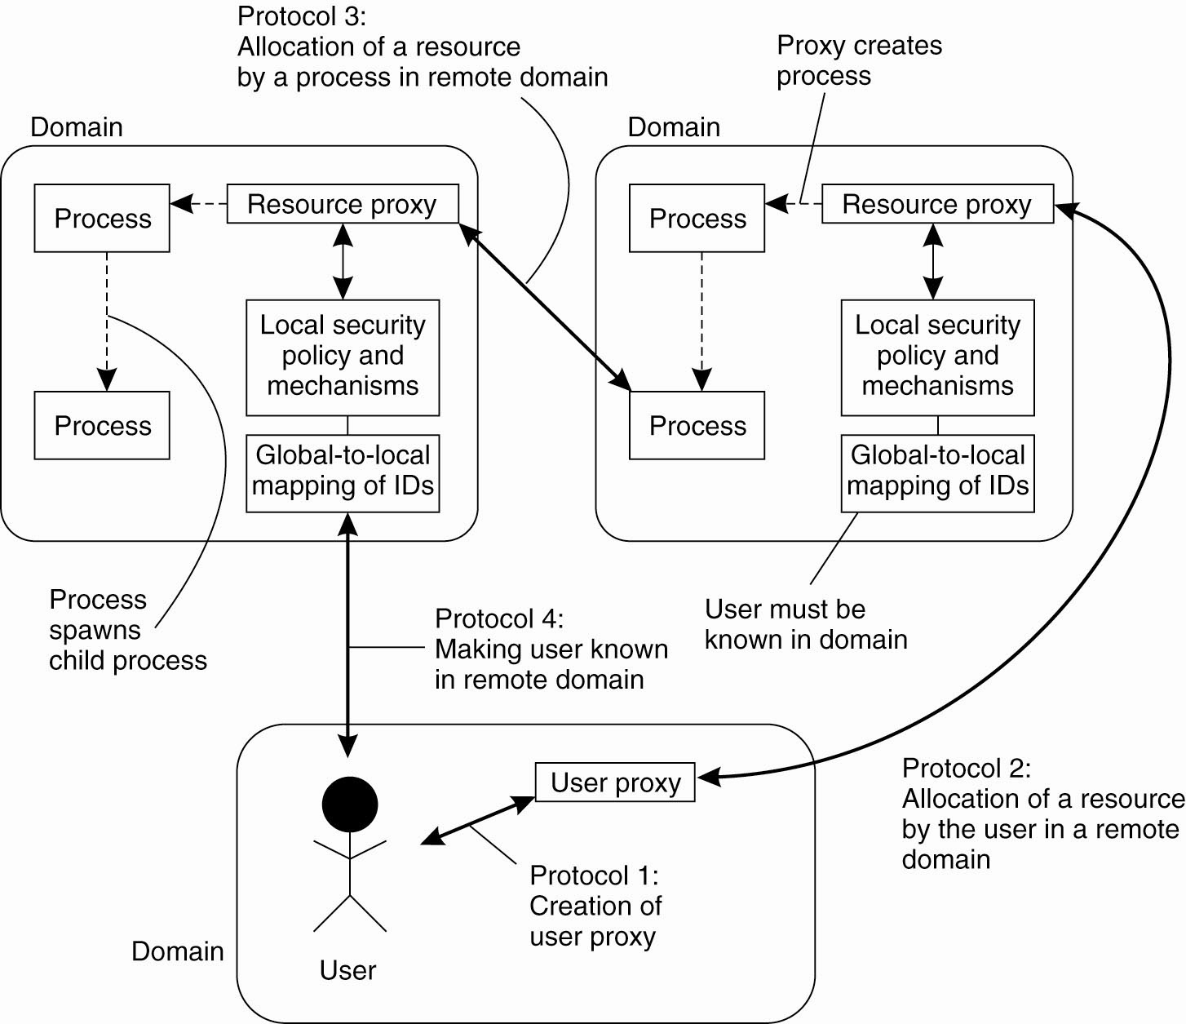
Example: The Globus
Security Architecture (2)
The Globus security architecture.

Slide 7
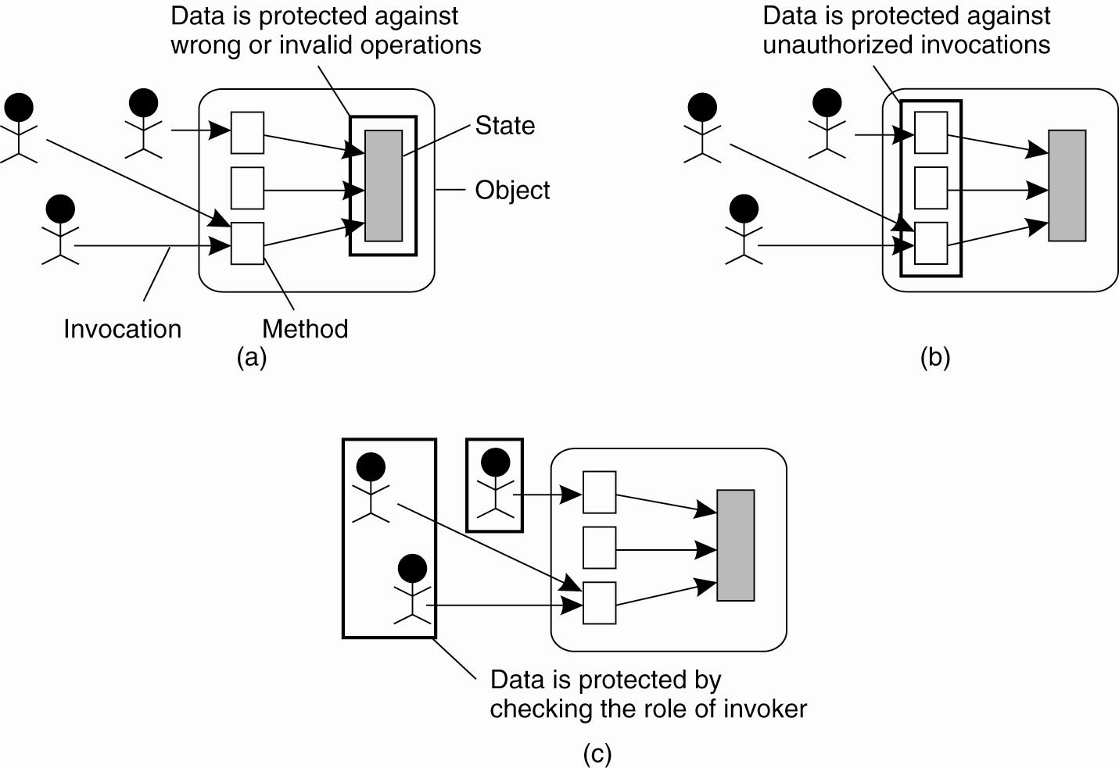
Focus of Control (1)
Three approaches for protection against security threats. (a) Protection against invalid operations.

Slide 8
Focus of Control (2)
Three approaches for protection against security threats. (b) Protection against unauthorized invocations.

Slide 9
Focus of Control (3)
Three approaches for protection against security threats. (c) Protection against unauthorized users.

Slide 10
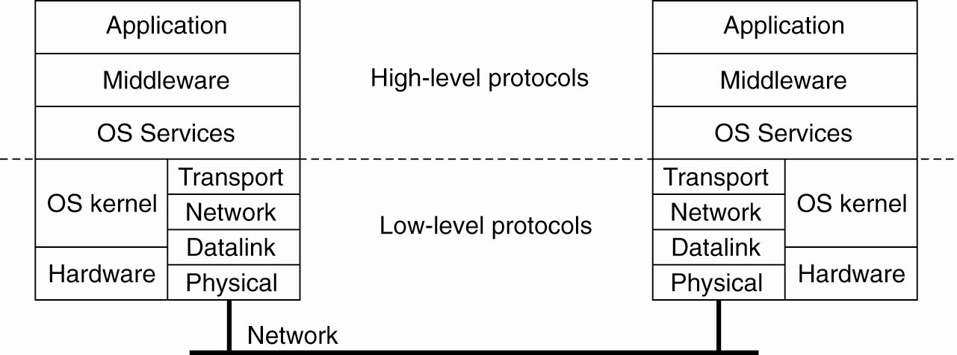
Layering of Security Mechanisms (1)
The logical organization of a distributed system into several layers

Slide 11
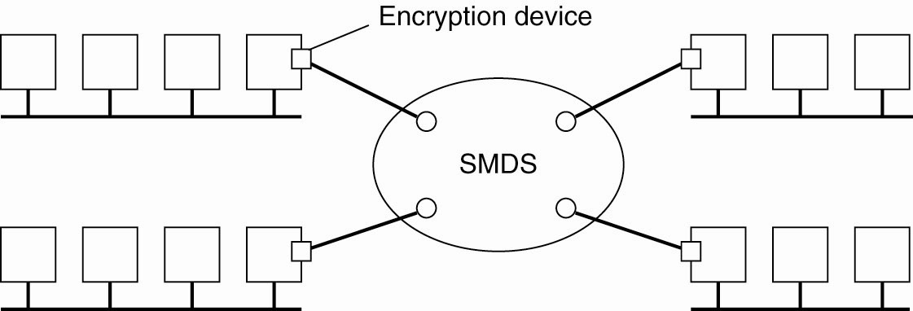
Layering of Security Mechanisms (2)
Several sites connected through a wide-area backbone service

Slide 12
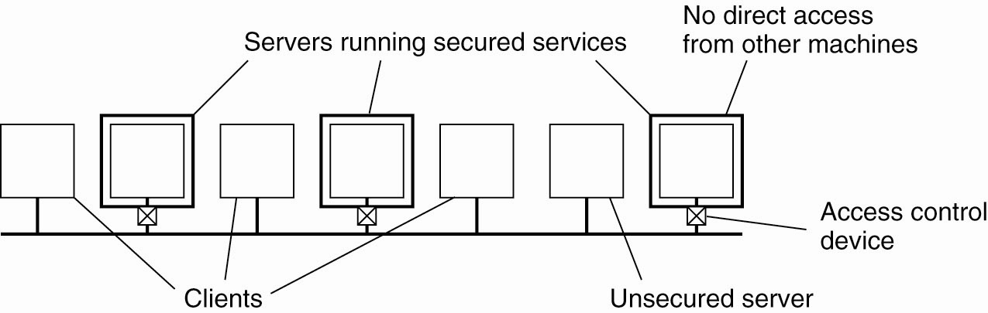
Distribution of Security Mechanisms
The principle of RISSC as applied to secure distributed systems

Slide 13
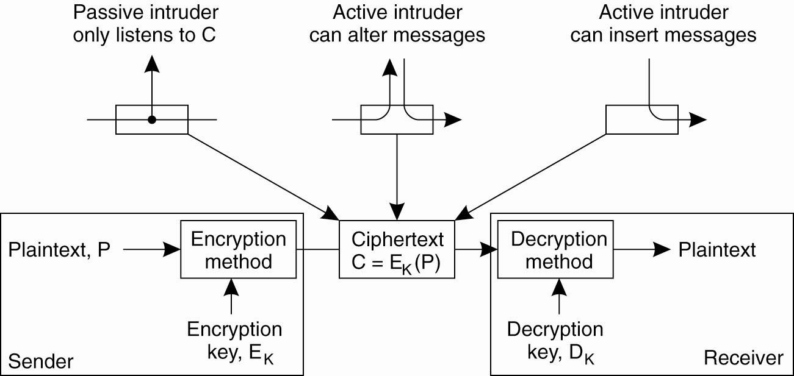
Cryptography (1)
Intruders and eavesdroppers in communication

Slide 14
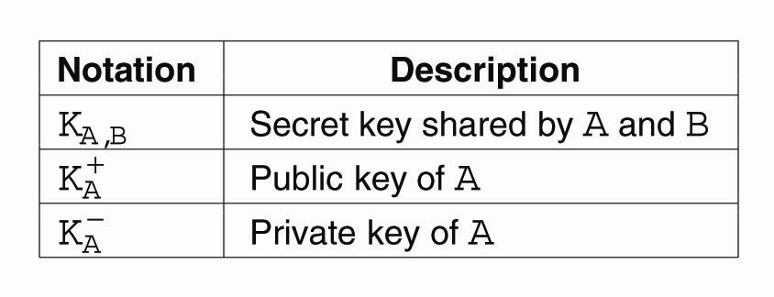
Cryptography (2)
Notation used in this presentation

Slide 15
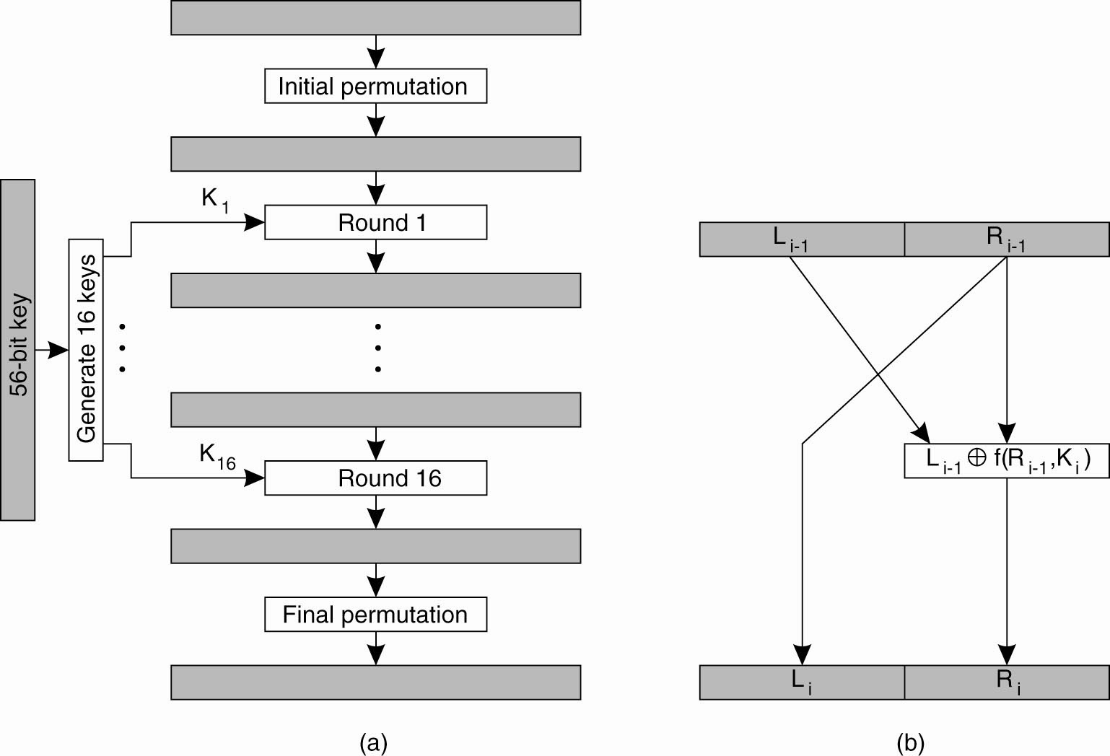
Symmetric Cryptosystems: DES (1)
(a) The principle of DES

Slide 16
Symmetric Cryptosystems: DES (2)
(b) Outline of one encryption round

Slide 17
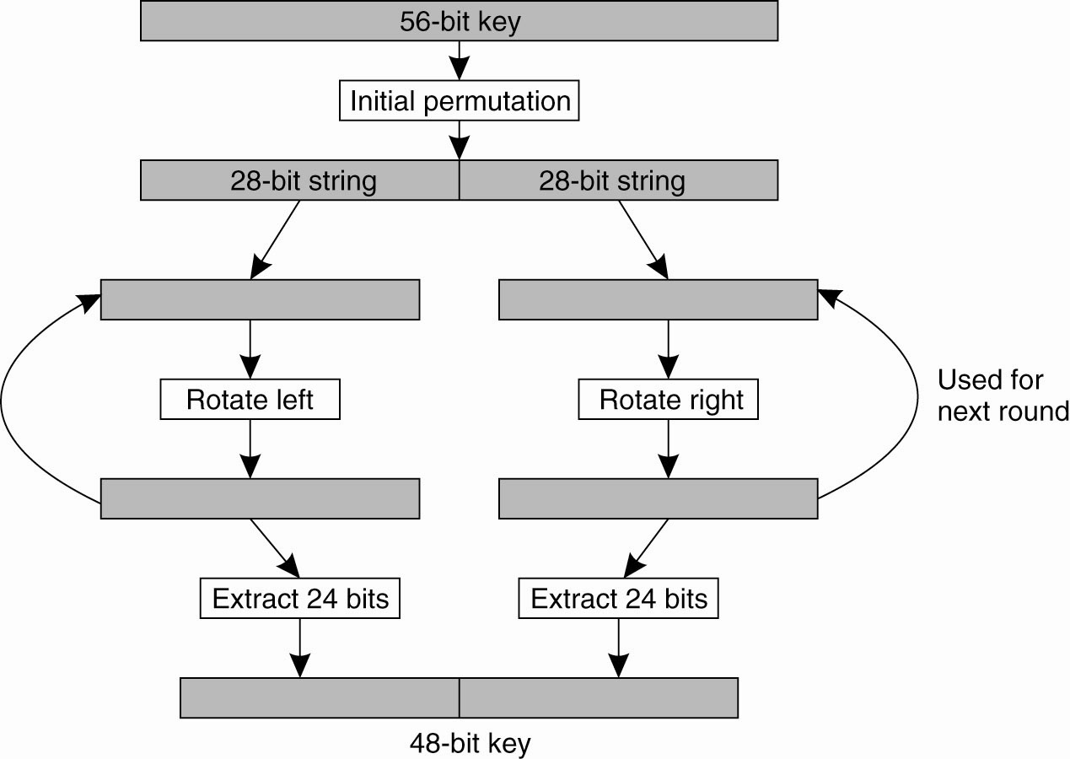
Symmetric Cryptosystems: DES (3)
Details of per-round key generation in DES

Slide 18
Public-Key Cryptosystems: RSA
Generating the private and public keys requires four steps:
Choose two very large prime numbers,
p and q.
Compute n = p × q and z = (p − 1) × (q − 1).
Choose a number d that is relatively prime
to z.
Compute the number e such that
e × d = 1 mod z.

Slide 19
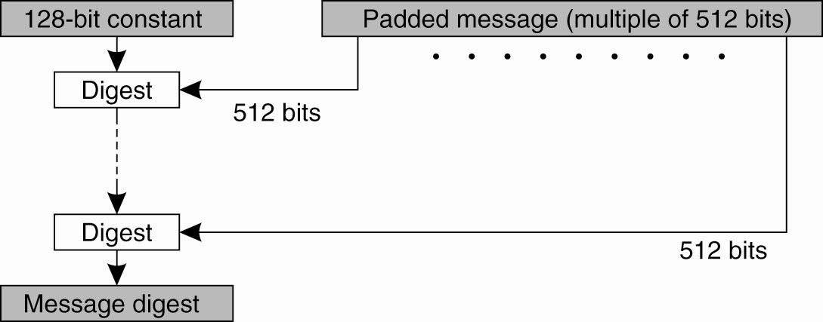
Hash Functions: MD5 (1)
The structure of MD5

Slide 20
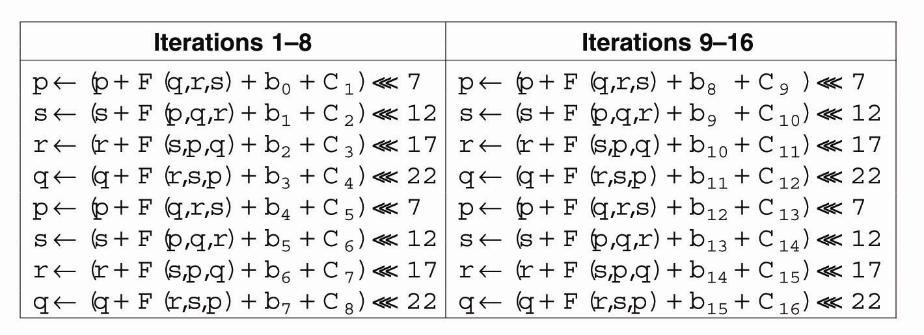
Hash Functions: MD5 (2)
The 16 iterations during the
first round in a phase in MD5

Slide 21
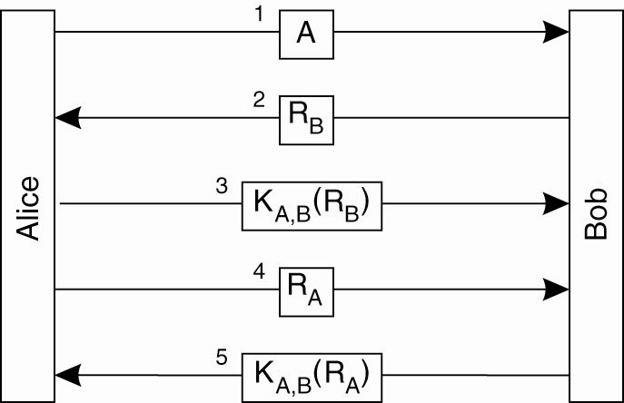
Authentication Based on a Shared Secret Key (1)
Authentication based on a shared secret key

Slide 22
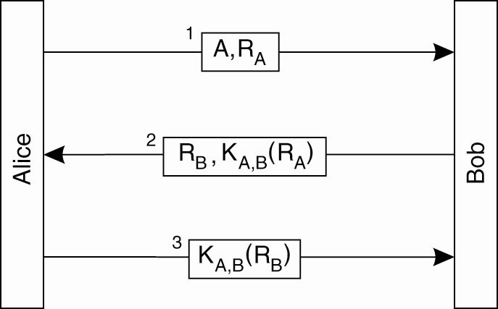
Authentication Based on a Shared Secret Key (2)
Authentication based on a shared secret key,
but using three instead of five messages

Slide 23
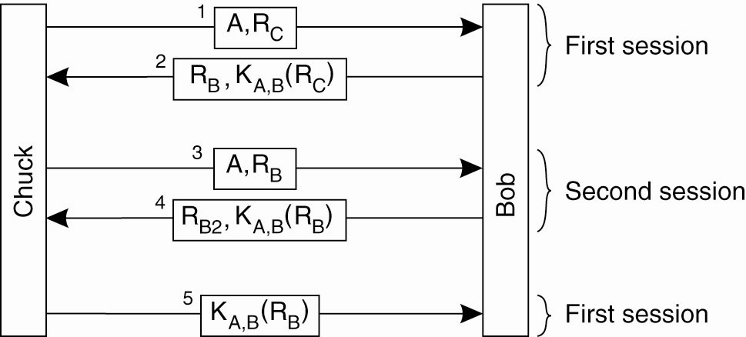
Authentication Based on a Shared Secret Key (3)
The reflection attack

Slide 24
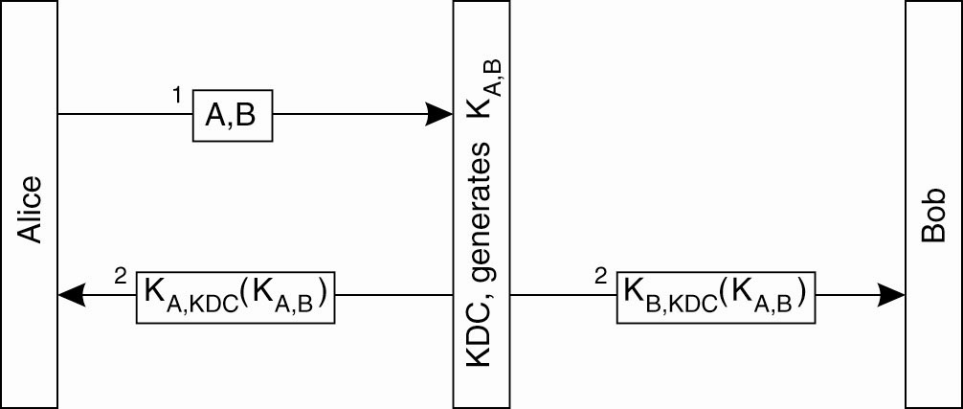
Authentication Using a
Key Distribution Center (1)
The principle of using a KDC

Slide 25
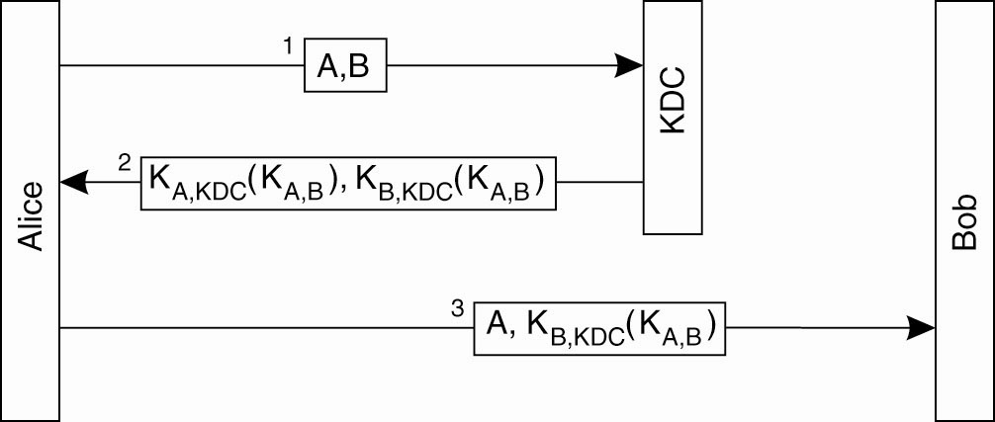
Authentication Using a
Key Distribution Center (2)
Using a ticket and letting Alice
set up a connection to Bob

Slide 26
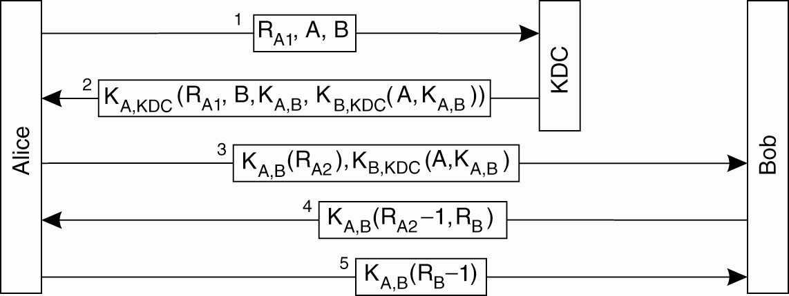
Authentication Using a
Key Distribution Center (3)
The Needham-Schroeder authentication protocol

Slide 27
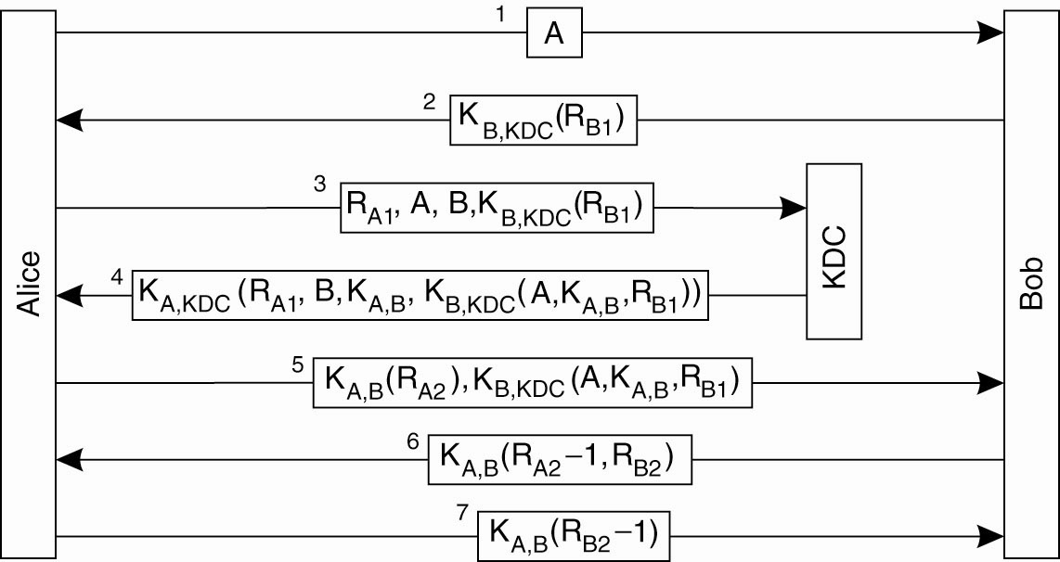
Authentication Using a
Key Distribution Center (4)
Protection against malicious reuse of a previously generated session key in the Needham-Schroeder protocol

Slide 28
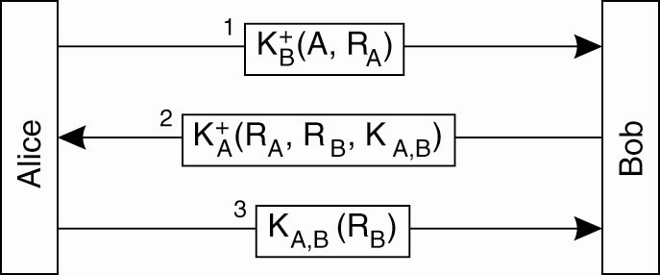
Authentication Using a
Key Distribution Center (5)
Mutual authentication in a public-key cryptosystem

Slide 29
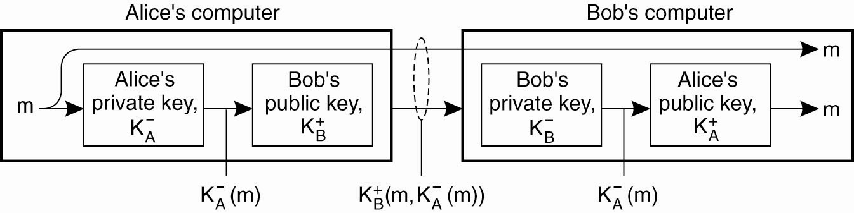
Digital Signatures (1)
Digital signing a message
using public-key cryptography

Slide 30
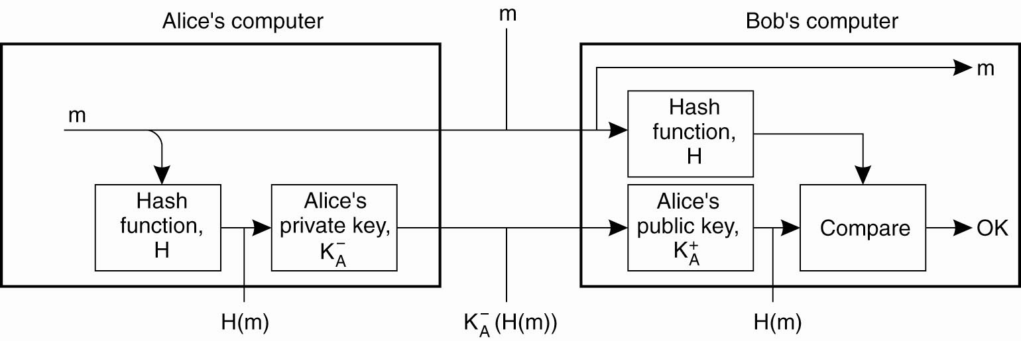
Digital Signatures (2)
Digitally signing a message using a message digest

Slide 31
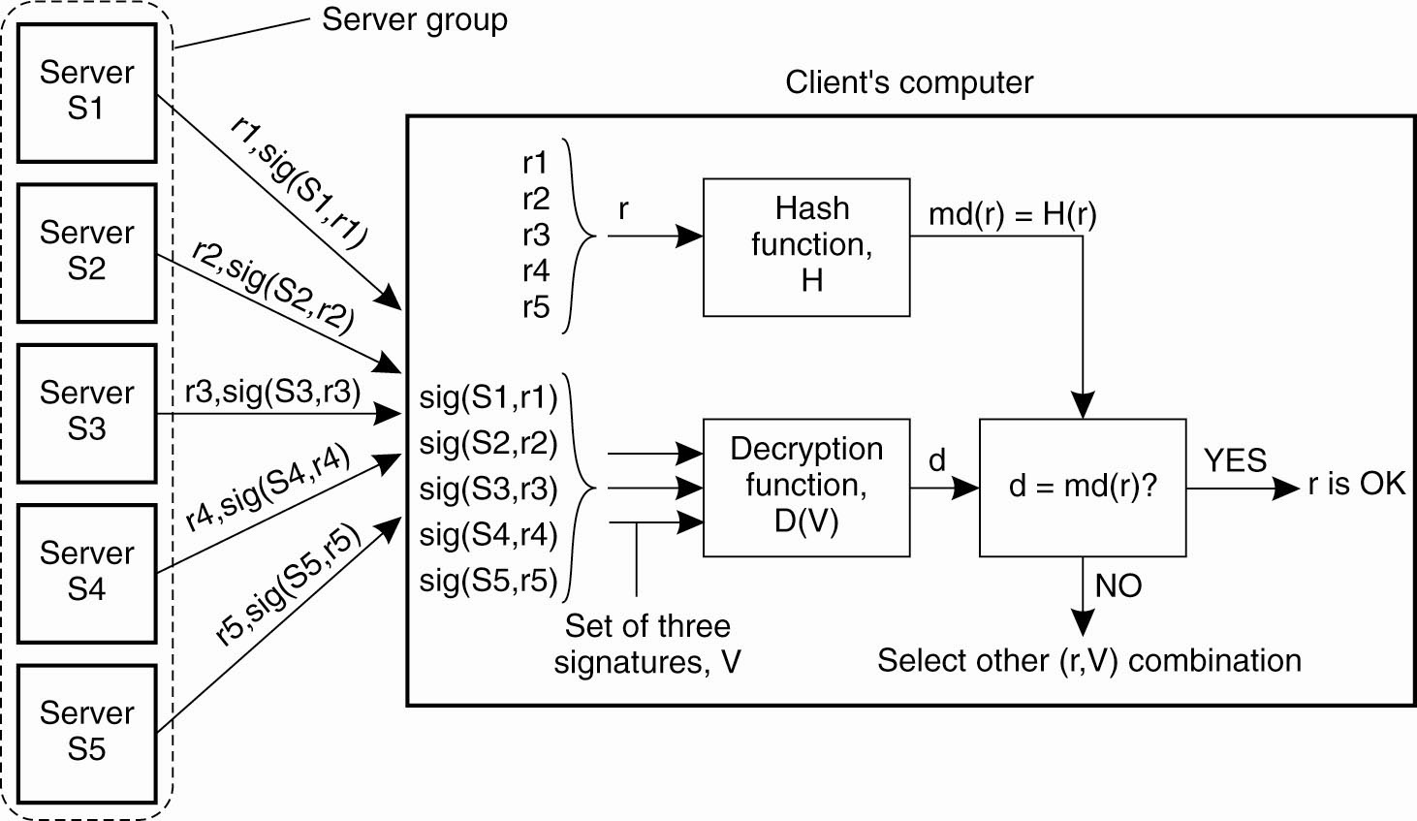
Secure Replicated Servers
Sharing a secret signature in a group of replicated servers

Slide 32
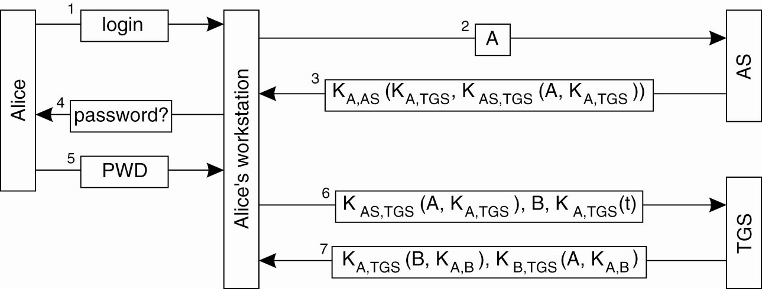
Example: Kerberos (1)
Authentication in Kerberos

Slide 33
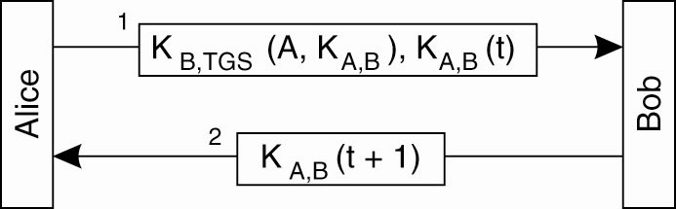
Example: Kerberos (2)
Setting up a secure channel in Kerberos

Slide 34
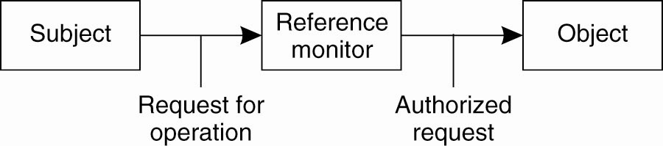
General Issues in Access Control
General model of controlling access to objects

Slide 35
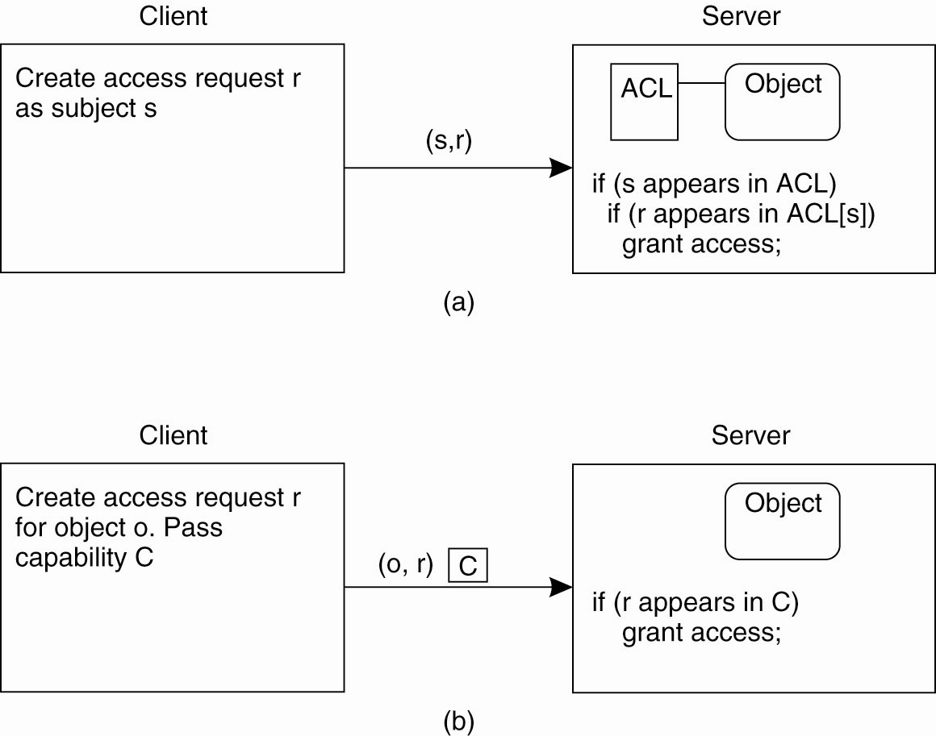
Access Control Matrix (1)
Comparison between ACLs and capabilities for protecting objects. (a) Using an ACL.

Slide 36
Access Control Matrix (2)
Comparison between ACLs and capabilities for protecting objects. (b) Using capabilities.

Slide 37
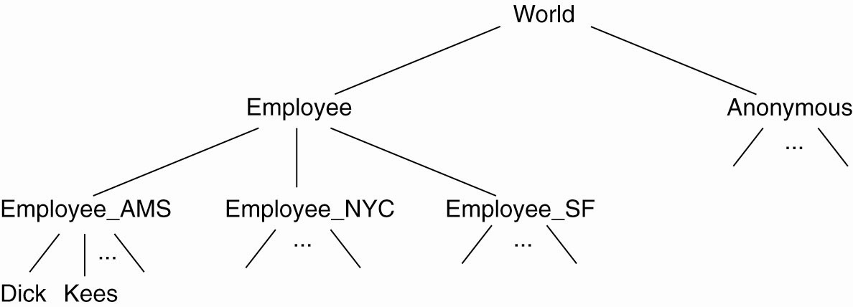
Protection Domains
The hierarchical organization of
protection domains as groups of users

Slide 38
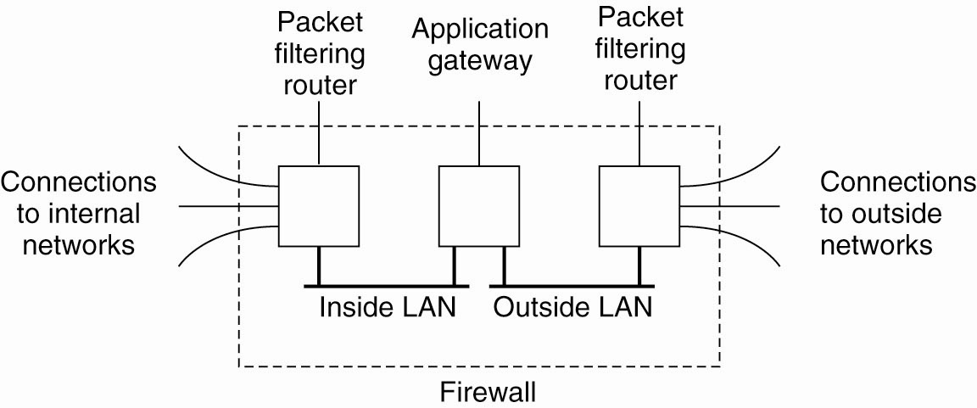
Firewalls
A common implementation of a firewall

Slide 39
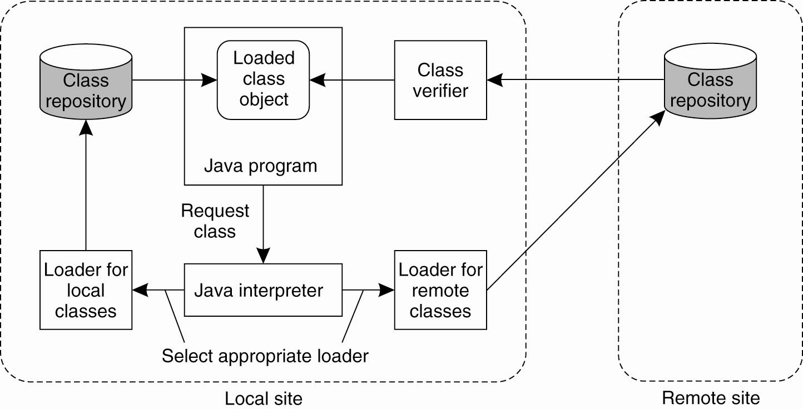
Protecting the Target (1)
The organization of a Java sandbox

Slide 40
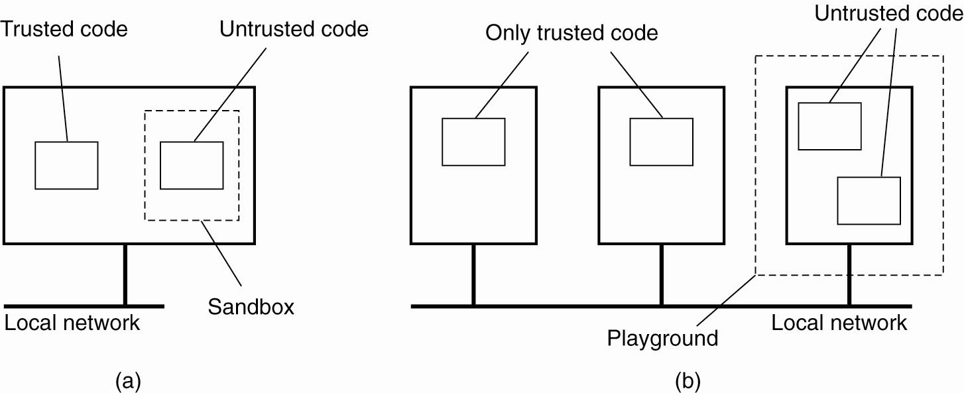
Protecting the Target (2)
(a) A sandbox. (b) A playground.

Slide 41
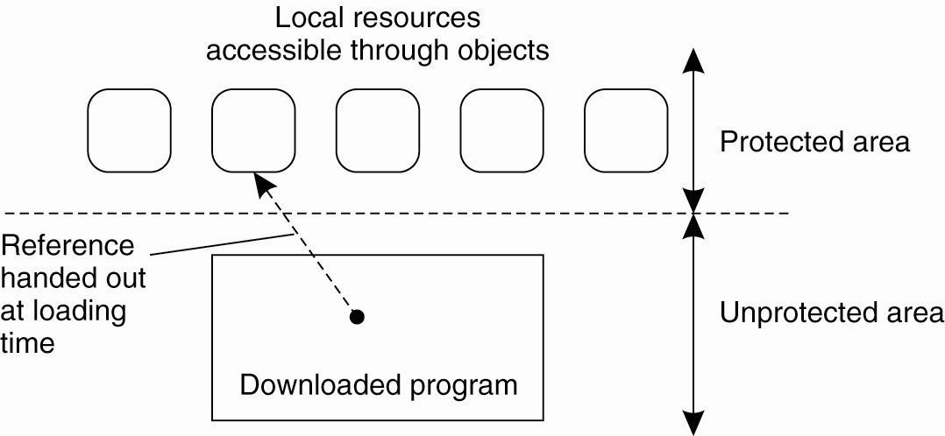
Protecting the Target (3)
The principle of using Java object
references as capabilities

Slide 42
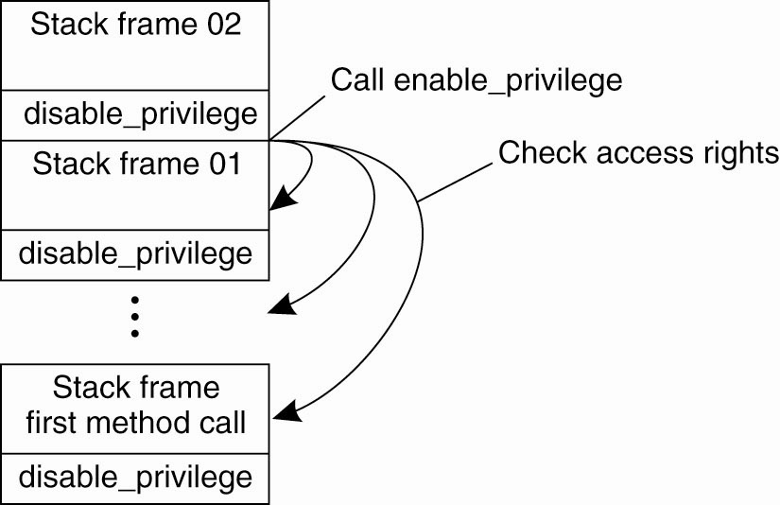
Protecting the Target (4)
The principle of stack introspection

Slide 43
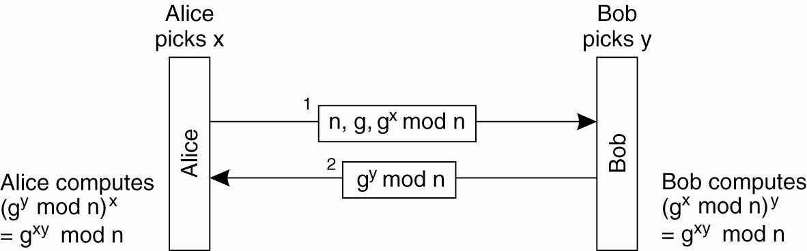
Key Establishment
The principle of Diffie-Hellman key exchange

Slide 44
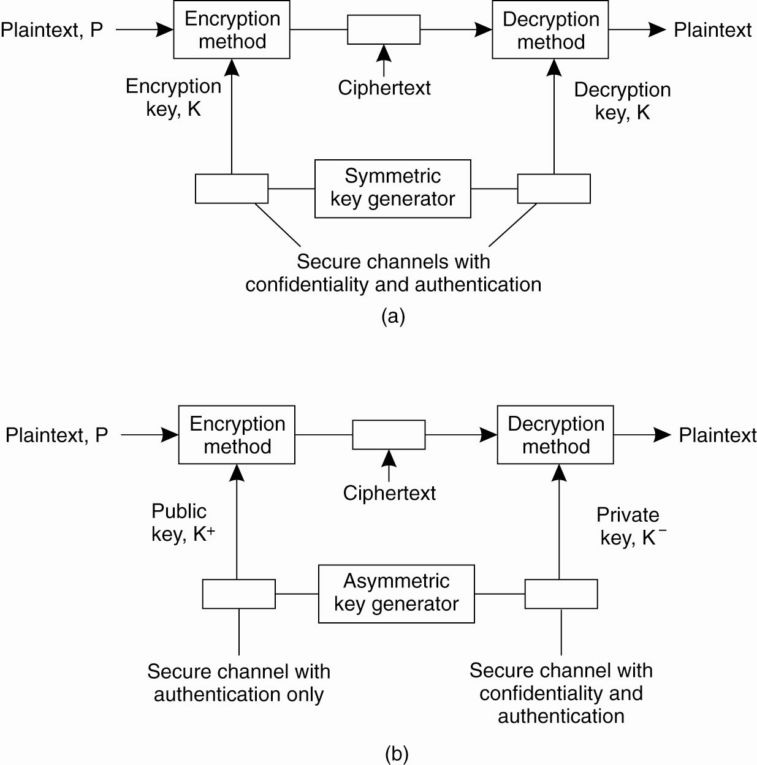
Key Distribution (1)
(a) Secret-key distribution [see Menezes et al. (1996)]

Slide 45
Key Distribution (2)
(b) Public-key distribution [see also Menezes et al. (1996)]

Slide 46
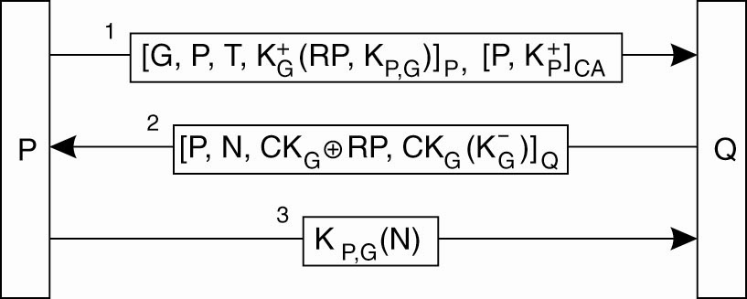
Secure Group Management
Securely admitting a new group member

Slide 47

Capabilities & Attribute Certificates (1)
A capability in Amoeba

Slide 48
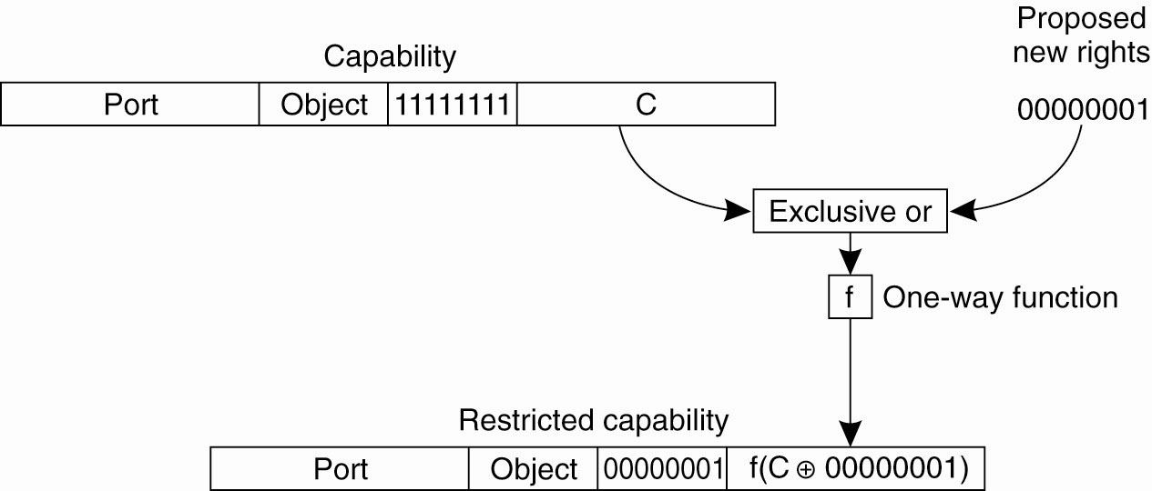
Capabilities & Attribute Certificates (2)
Generation of a restricted capability
from an owner capability

Slide 49
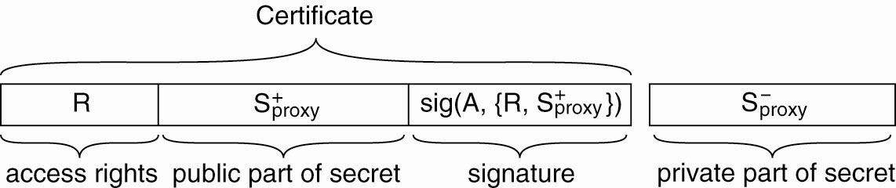
Delegation (1)
The general structure of a
proxy as used for delegation

Slide 50
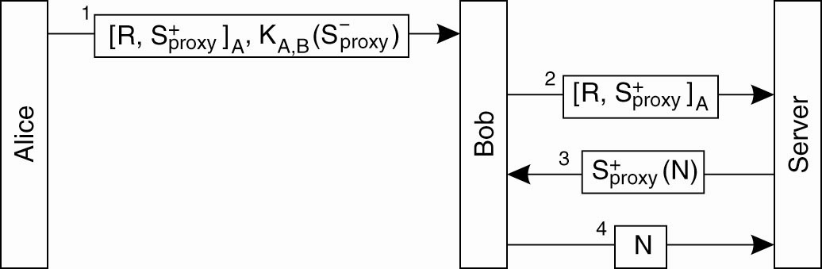
Delegation (2)
Using a proxy to delegate and
prove ownership of access rights

